Slide 1
Can We Predict Tradable Markets?
Experimenting with Machine Learning Approaches

Slide 2
Agenda
This case deploys time-series analysis to spot time-dependent patterns for publicly traded markets.
In this project, the ARIMA and LSTM (and their variations) models are utlized as frameworks to spot potential underlying patterns in the publicly traded commodity -- gold.

Slide 3
What is ARIMA
ARIMA stands for AutoRegressive Integrated Moving Average.
It is a popular and widely used time-series forecasting model in statistics and econometrics.
ARIMA models are employed to render predictions based on past data points in a time-series.
These models are particularly useful for capturing and forecasting trends and patterns in time-dependent data.

Slide 4
ARIMA limitations
ARIMA assumes independent identical datapoints (IID) within a time-series, however:
Not all time-based data points within publicly tradable instruments are necessarily IID- For instance, a time data point with no trades has the same parameters as a data point with many trades.
ARIMA assumes stationarity, however:
Differencing the underlying trend ignores or diminishes the value of that trend within the analysis
ARIMA models work well when the underlying relationships in the time series data are linear, however:
New information may enter market dynamics at any time, thus, relationships between data points may not be linear

Slide 5
What is a LSTM?
LSTMs are a specialized type of neural network architecture that remember, learn, and generalize patterns in sequential data, making them particularly valuable for tasks where temporal dependencies play a crucial role.

Slide 6
LSTM Advantages over ARIMA
Neural networks are not as linearly deterministic as ARIMA models. They can glean insights from past patterns and generalize patterns into unseen future scenarios.
LSTM is not framed around stochastic modeling, but overall pattern detection, which may offer a more flexible modality to frame market dynamics. This includes offering reasoning capabilities that may filter through the 'noise' of the markets better than ARIMA.
LSTM does not depend on stationary data (the markets are not stationary, but instead exhibit drift, momentum, or reversion tendencies)

Slide 7
Why did we choose Gold for this study?
The optimal instrument for an ARIMA model should characterize the mathematical axioms/assumptions noted above. As such:
1) Individual stocks seem ill suited for an ARIMA model:
With individual stock earnings call incurring once a quarter, IID is not assumed.
There is also well-documented (and visualized) drift in most individual stocks, and thus, price dynamics are not stationary
Just as importantly, individual stocks are dynamic and evolving, and moving averages and auto-regressive relationships derived from past sample sizes may become outdated determinants of future prices.
2) Stock ETFs may present as a suitable choice:
Stock ETFs continuously digest information, where material information is approximately equal value across all data points, and thus, exhibit characteristics more closely aligned with IID.
Thus, ETFs generally do not exhibit as wide-ranging volatilities and drift as individual stocks. Thus, it is a better approximator of ARIMA mathematical structures.
3) Gold:
Similarly to Stock ETFs, Gold’s pricing dynamics and fundamentals continuously digest information, but not merely from socio-economic fundamentals within the US, but the entire global ecosystem.
Even more, gold possesses the longest history as a tradable instrument within human economies. Thus, for the wide breadth of variables that underlie gold’s pricing dynamics, and its extensive history as documented tradable instrument, gold was chosen for the ARIMA and LSTM model.

Slide 8
Data Sourcing and Data Wrangling
The python module YFinance was utilized for this study
The YFinance module is directly connected to Yahoo Finance’s historical data records
Because this module is intended for research purposes, the characteristics of the data are already well prepared for manipulation. Thus little to no data wrangling was required.

Slide 9
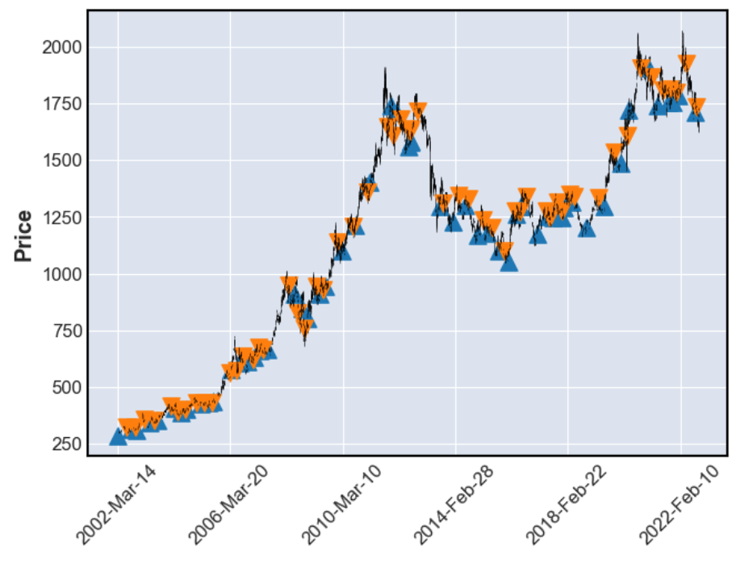
Exploratory Data Analysis: Moving Average Crossover strategy (50 day x 200 day cross)

Slide 10
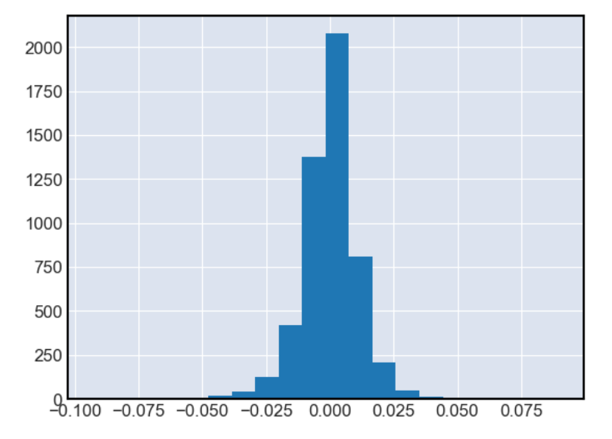
Gold Histogram of Price Return Percentage per Day: Approximates Normal Distribution (with drift)

Slide 11
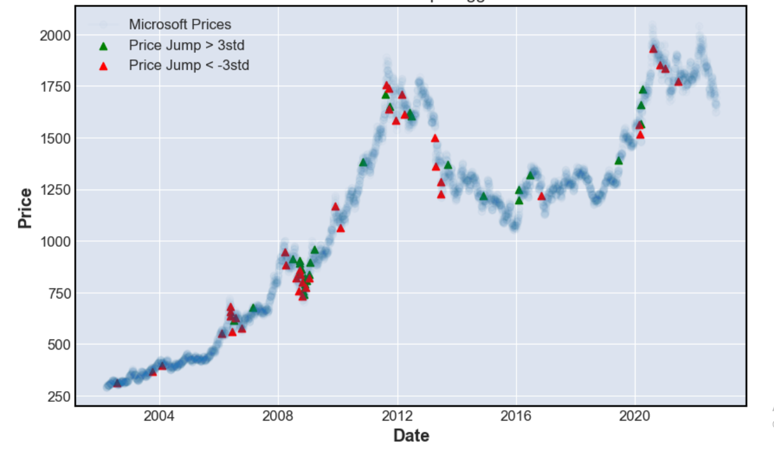
Gold Price Jumps and Dips of 3STD: Volatility leads to more volatility – Time Series not IID

Slide 12
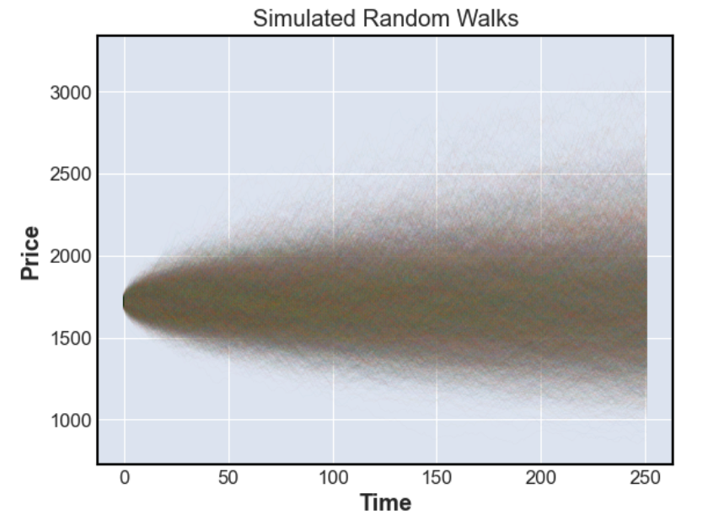
Simulated Random Walk: 95% Confidence Interval is between 1372 - 2069

Slide 13
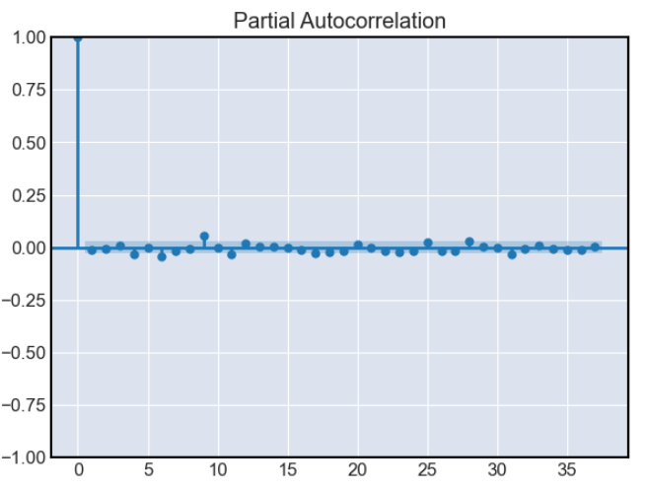
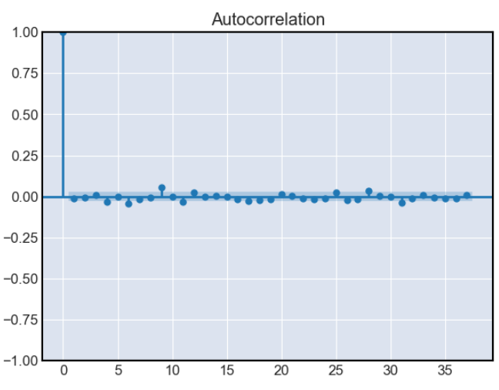
Pre Processing and Training
Using Adfuller, Stationarity = True
Test Stat: -22
P-value: .00 (rounded to two decimal places)
P and Q values for ARIMA = 0 (based on below charts)

Slide 14
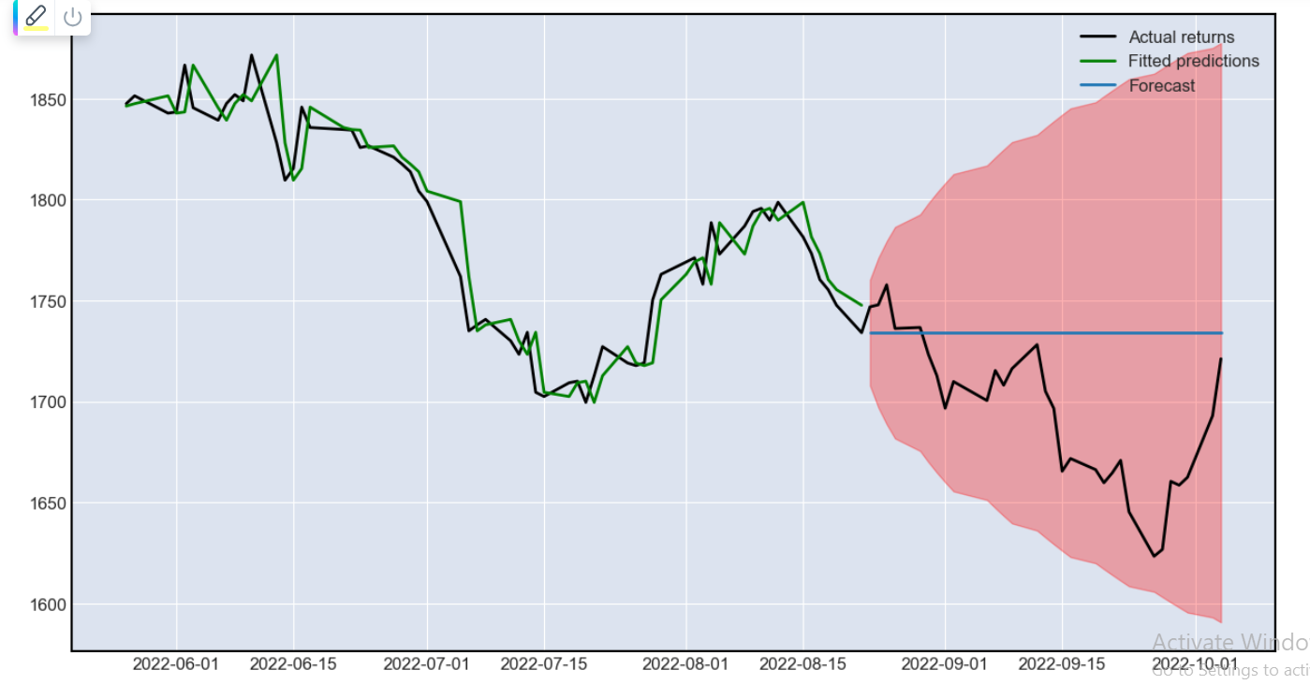
ARIMA Predictions

Slide 15
ARIMA Performance Metrics
The performance metric of the test dataset vs prediction:
RMSE: 53.37952273665021
MAE: 43.46999918619792
This equates to roughly 4% off the actual gold price
Given that the standard deviation is 1%, this is actually not a spectacular result
However, this is because the test dataset predicts 30 periods into the future from the last datapont.
Recommendation: If ARIMA is utilized for each successive real data point into the future, the performance metric will improve dramatically

Slide 16
ARIMA Analysis
The empirical results align with the expectations derived during EDA:
The mathematical structures defined by ARIMA are not well-suited for stock prediction.
Furthermore, in pursuit of positive investment returns, predicting market directionality is also imperative. Even with ARIMA's projected prices, it's difficult to discern when real price is expected to converge with ARIMA's projected price into the future.
Recommendation 1: having stated the above, a mean reversion strategy may be worthy of further research.
Potential strategy: When ARIMA's calculated price deviates greatly from real price, these are days a trader can buy/sell the stock in expectation it will eventually revert to ARIMA's projected price. Further investigation is necessary to validate this strategy.
Recommendation 2: However, the 95% confidence interval produced by ARIMA surpasses the simulated random walk's confidence interval; ARIMA may have applications as a quick risk-management tool.

Slide 17
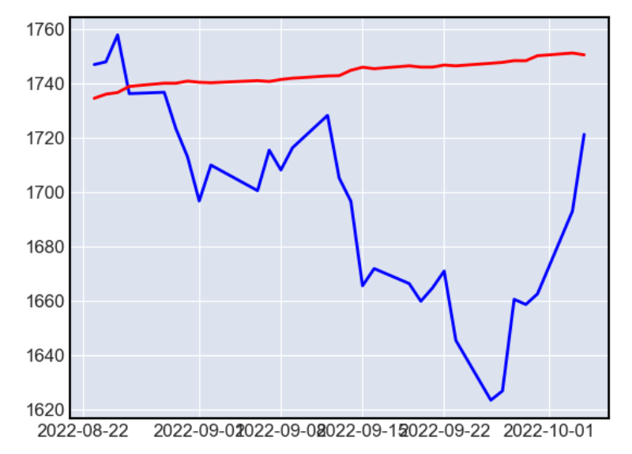
SARIMAX MODEL (seasonal adjusted ARIMA)
SARIMA performance metrics on test data:
RMSE - 62.87
MAE - 52.36
SARIMA did not perform better than ARIMA, suggesting that Gold Prices do not have a consistent seasonal component

Slide 18
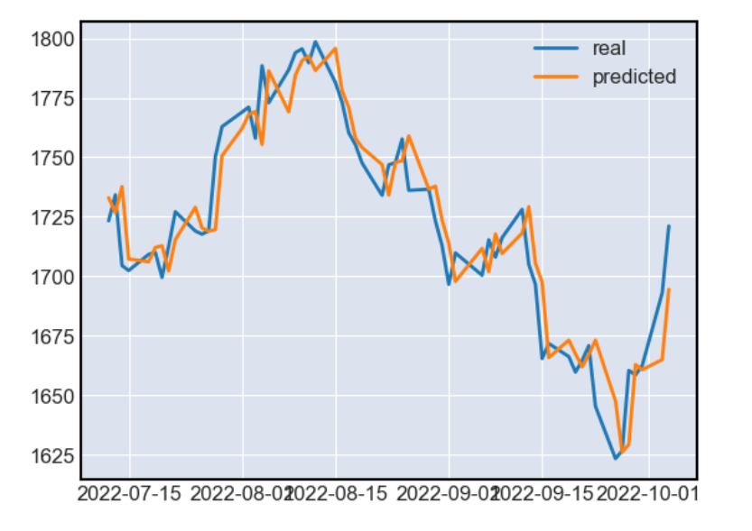
LSTM Results and Analysis
Analysis:
- LSTM produces much better results vs ARIMA
- This is most likely due to LSTM's 60 period rolling window and the neural network's ability to generalize (non-linear) insights from within this window for projection into future scenarios.
The RMSE and MAE are respectively 17.185049539220337 and 11.97571214779403
- LSTM predictions are roughly 1% off the real price, which is roughly to equal the std of the deviations. LSTM does not perform significantly better than STD, and thus, is not a valuable predictive model.

Slide 19
Review of Performance Metrics
ARIMA
Train RMSE: RMSE: 13.9
Train MAE: MAE: 8.76
Test RMSE: 53.37952273665021
Test MAE: 43.46999918619792
SARIMA:
Test RMSE - 62.87
Test MAE - 52.36
LSTM:
Test RMSE: 17.185049539220337
Test MAE: 11.97571214779403

Slide 20
Further insights
Overall conclusion:
For the reasons stipulated in the Context and Limitations section, ARIMA and LSTM (in this case study) do not seem to offer accurate frameworks to capture the dynamic equilibriums of publicly tradable markets, although there are many other potential routes to investigate
RECOMMENDATIONS TO CONSIDER:
Market psychology figures prominently into the markets. Coinciding with the frameworks of behavioral finance, diverse pricing equilibriums are established via different underlying trading psychologies, and the distinct price actions that set each equilbrium can be categorized into different states.
For instance, when uncertainty hits the markets, markets are characterized by wild volatility before an eventual equilibrium is reached. When prices are certain, markets are characterized by trending markets.
Categorizing market conditions into these two distinct states alone will obfuscate and confuse the current ARIMA and LSTM models (in this case study), for the models assume IID / stationarity etc, and will not compute distinctions across data points between uncertain vs certain market conditions with disparate market-participant psychologies and dissimilar resulting price actions, whether within intraday time windows or over longer time horizons.
There may be other mathematical structures that more accurately frame market conditions, such as Hidden Markov Models that delineate transitions between states.
Additionally, the preliminary MA crossover results buttress the hypothesis of market states. The MA crossover strategy suggests markets settle into distinct states, which then result in trending states under certain conditions.
This further explains why stochastic-based models such as ARIMA (in this case study) fail.

